Slide 1
Microservices
Web-420

Slide 2
What are Microservices?
an architectural style that structures an application as a collection of services
Services are highly maintainable and testable
Loosely coupled
Independently deployable
Organized around business capabilities
Light-weight protocols

Slide 3
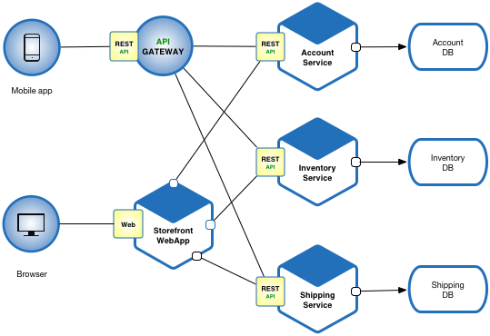
Example of a Microservice Architecture
Richardson, 2019

Slide 4
What is an API-Gateway?
A server that is a single entry point into the system
It takes all API requests from a client
It determines which services are needed
Services are combined into a synchronous experience for the user
It provides an API that is tailored to each client
It is responsible for composition & protocol translation

Slide 5
What are the Advantages of Microservices?
Applications become easier to build
Easier to maintain applications, because they are split into smaller, composable fragments
Allows teams to focus on building business functionality
Allows teams to develop different components simultaneously, speeding up productivity
Allows services written in different programming languages to coexist
Allows teams to work autonomously in small groups and make technical decisions quickly

Slide 6
What are the Disadvantages of Microservices?
More complex than monolithic applications
Existing tools might not be designed to work with service dependencies
More moving parts involved
Complexity is directly correlated with the number of services involved
Increase in testing required causes increased demand for automation
Increase in documentation overhead

Slide 7
How are Microservices Deployed in a Production Environment?
Service Instance per Host Pattern
Run each service instance in isolation on its own host benefits
Due to isolation, a service can’t steal resources, such as CPU and memory, from other services
Encapsulates implementation technology
Use cloud services - build a cluster
De-centralize data management

Slide 8
More facts about Microservices Deployment
Less efficient resource utilization
Every service instance has overhead of an entire virtual machine, including operating system
To help eliminate overhead, automate infrastructure deployment
Deploying a new version is usually slow to build
Slow to instantiate and start up because of its size
Keep code at a similar level of maturity

Slide 9
More facts about Microservices Deployment
Use separate builds for each Microservice
Minimize dependencies
Ensure services pull a correct version of a component file
Extract outdated versions
Have fast, frictionless processes
Monitor, Log & Troubleshoot!

Slide 10
How Microservices are Scaled
Measure Performance
Maintain Performance
Assure Resource Allocation
Consider Individual Components
Consider Whole System
Consider CPU & RAM

Slide 11
References
Phil Wittmer. (2018, Nov 14). Microservices Disadvantages & Advantages (blog). Retrieved from https://www.tiempodev.com/blog/disadvantages-of-a-microservices-architecture/
Richardson, C. (2019). What are microservices? Retrieved December 5, 2019, from https://microservices.io/
5 Major Benefits of Microservice Architecture. (2018, Mar 02). (No author). Retrieved from https://skelia.com/articles/5-major-benefits-microservice-architecture/
Chris Richardson. (2016, Feb 10). Choosing A Microservices Deployment Strategy (blog). Retrieved from https://www.nginx.com/blog/deploying-microservices/

